Slide 1
SP5 - Neuroinformatics SynapsesSA
Tutorial
Computational Intelligence Group
Technical University of Madrid

Slide 2
Outline
Installation and first run
Load data
Model synapses
Create simulations
Compare layers

Slide 3
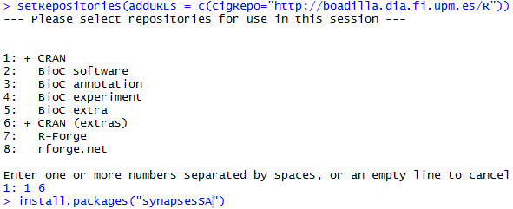
Installation and first run
Guidelines
Described in detail in synapsesSA user manual
Demo available online at http://boadilla.dia.fi.upm.es/hbp/synapsesSA
Installation
R environment and internet access required
Add CIG R Repository
Install synapsesSA package
Run
Load synapsesSA library
Run graphical user Interface

Slide 4
Load data
How to create a CSV file
Header row with fixed names is MANDATORY
Column names:
Sample.no.
Layer
Feret
X
Y
Z
Type [optional]
Spreadsheet editor
Open data file with any spreadsheet editor (Excel, Calc, ..)
Click on ‘save as…’ in the file menu
Select comma separated values (.csv) format and save the file
Additional columns will be ignored
Sample.no. Feret, X, Y, Z columns should be numeric
All measures should be in nanometers
Layer should be a roman number between I and VI

Slide 5
Load data
Adding missing columns
If Sample.no or Layer columns are missing they should be added before uploading the file into the application.
Sample1Layer3.csv
Add missing columns based on filename
Sample1Layer3_mod.csv

Slide 6
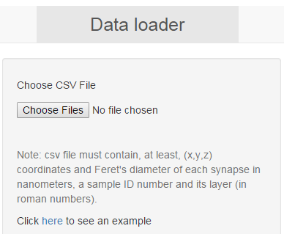
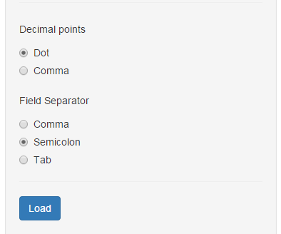
Load data
Uploading the file
Go to the data loader tab and click on the choose files button
Select CSV files and click Open
Set file options and click Load button. Repeat the process for each set of files

Slide 7
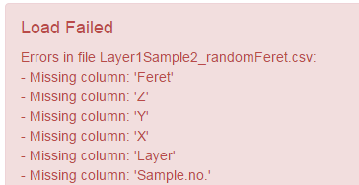
Load data
Errors
Missing Columns
Possible causes:
No such columns in the CSV file
Wrong field separator character selected
Missing header
Not numeric fields
Possible causes:
Header misplaced in the CSV file
Wrong decimal point character selected

Slide 8
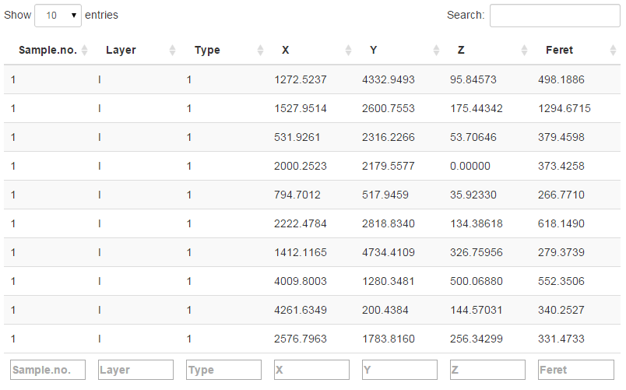
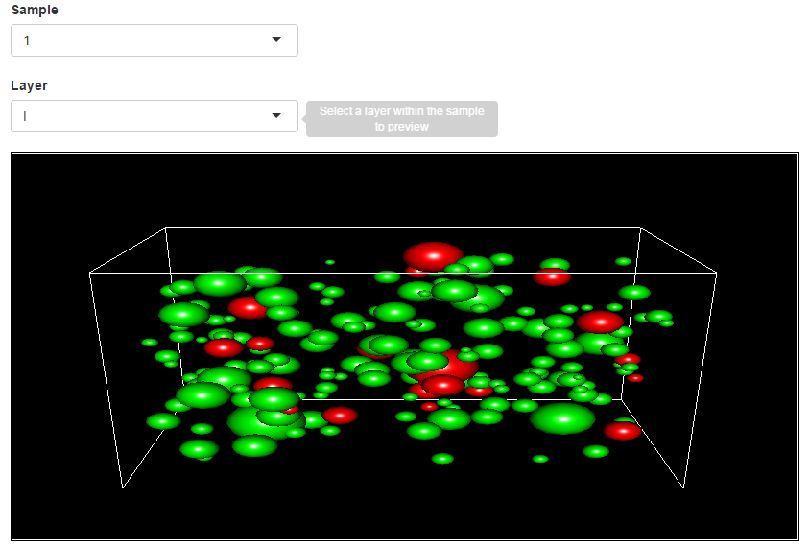
Load data
Preview
Data tables
Loaded data is displayed in a table
Each column can be ordered
Table support search by field
3D preview
Each sample is depicted individually
Each sphere represents a synapse
Green for symmetric synapses
Red for asymmetric ones

Slide 9
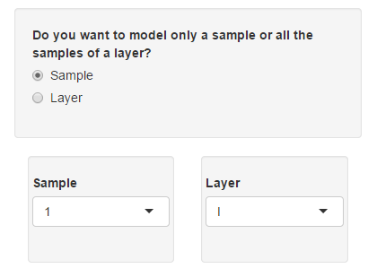
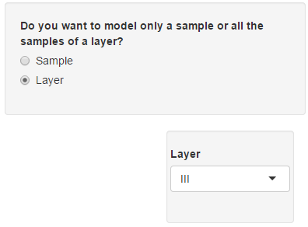
Modeling synapses
Select data
To select a single sample:
Select “Sample” in the radio button
Select sample ID and a layer within the sample
To select all samples from one layer:
Select “Layer” in the radio button
Select the layer on the selector

Slide 10
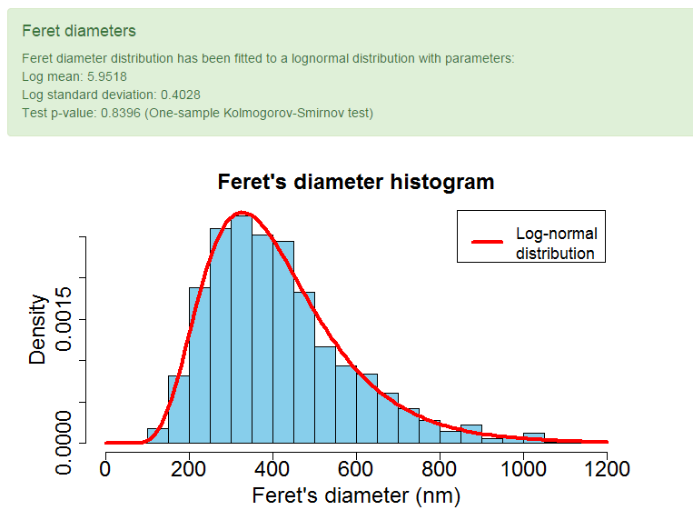
Modeling synapses
Fit Feret’s diameter
After data has been selected, Feret’s diameter fitting button activates
If we click on the button, synapsesSA tries to fit Feret’s diameters from selected data to a lognormal distribution
Two possible outputs:
Success
Failure
Feret’s diameters from selected data do not follow a log-normal distribution

Slide 11
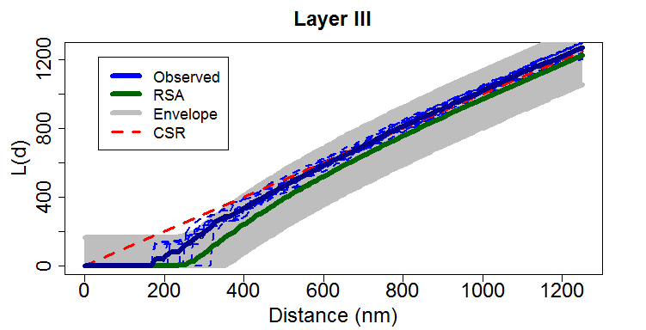
Modeling synapses
RSA point distribution
This only makes sense if the Feret’s parameter fitting has not been REJECTED
Evaluation is performed with respect to the characteristic L function
The calculation of the RSA model and its envelope is a computationally expensive process that can take up to several minutes
For the evaluation of single samples, cross-validated parameters are used
For layer evaluation, each sample from the layer is represented as a dashed line
If the curve that represents the observed data (blue) is bounded within the grey region (the envelope) data is said to follow a RSA distribution

Slide 12
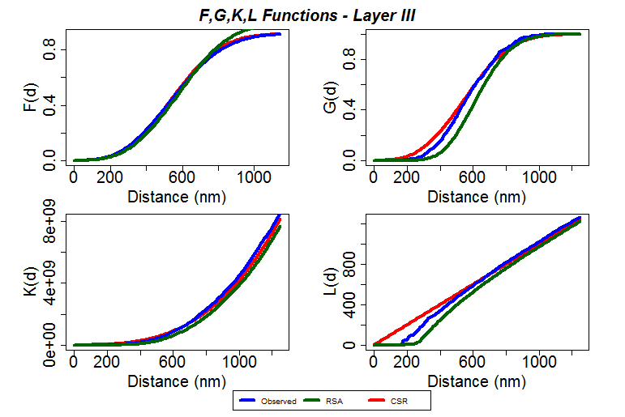
Modeling synapses
Summary functions
Summary functions are a set of indicators to characterize spatial distributions
synapsesSA creates a plot with four of the most commonly used functions:
F function measures the empty space
G function examines the cumulative frequency distribution of NN-distances divided by the intensity/density
K function measures the expected number of points at a certain distance
L function is a transformation of the K function that eases its interpretation

Slide 13
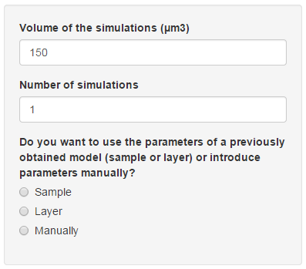
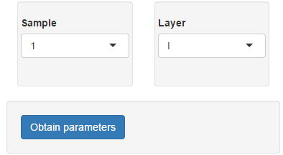
Create simulations
Options
The volume of the spatial domain to simulate
The number of simulations to generate
Determines the source of the simulation parameters:
From a single data sample
From all samples of a layer
Manual input
For the first two options, selected sample or layer has to be specified
The use parameters from a sample or layer that does not fulfill all previous assumptions (diameters log-normality and RSA distribution) could lead to inaccurate simulations

Slide 14
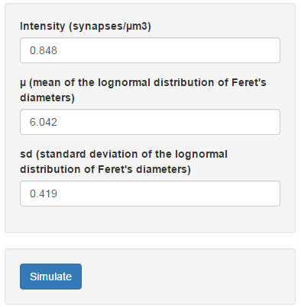
Create simulations
Set parameters
Model is determined by three parameters: Intensity, mu and sigma
The number of synapses per volume unit
Feret’s diameter log mean for the lognormal distribution
Feret’s diameter log standard deviation for the lognormal distribution
Click to compute simulations. This process might take some time depending on the parameters and the computer
For some selections of parameters the simulation process might fail.
For example, it will fail for extreme high density or large Feret’s diameters

Slide 15
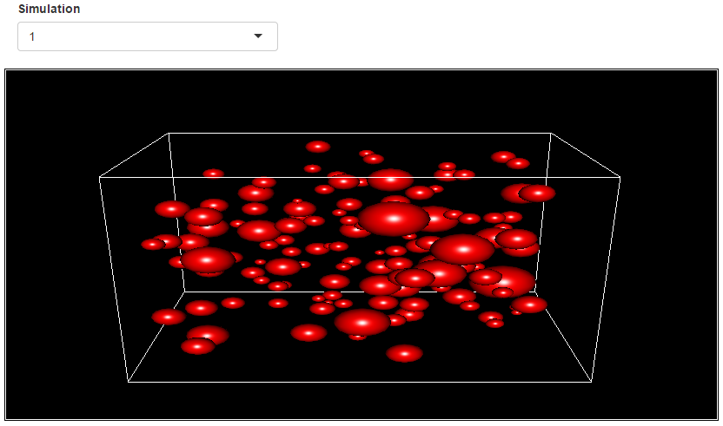
Create simulations
Download and Visualize results
Once simulations are completed, they can be visualized in a 3D plot in the main panel
Also, simulations can be downloaded in a CSV file using the Download simulations button

Slide 16
Layer comparison
General procedure
At least samples from two different layers are needed to perform layer comparisons
In every case, the procedure used to compare layers is the same:
Normality test is made for each layer
Variance homogeneity is tested by applying Levene test
If data is normal and variance is homogeneous
Use ANOVA analysis over the data
Apply TukeyHSD test to look for differences between layers
If data is not normal or variance is not homogeneous
Pairwise Kruskall-Wallis test is applied for every possible pair of layers
To show the results, a colored stacked-bar plot where each layer height is proportional to the real layer’s thickness is created

Slide 17
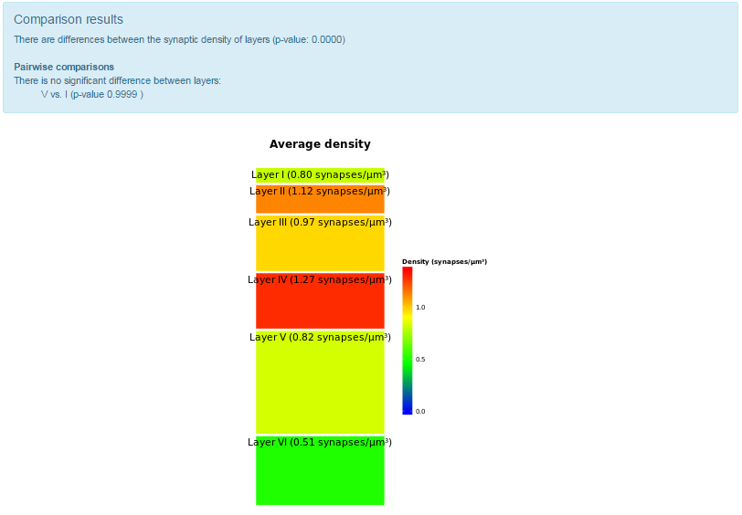
Layer comparison
Sample intensity
Two or more samples per layer are needed to perform sample intensity comparison
Select synaptic density and hit Calculate
Synaptic density is computed for each sample
Average density is computed as a sample volume-proportional mean to create the plot

Slide 18
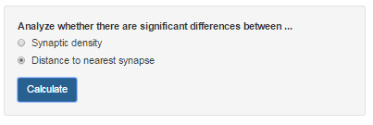
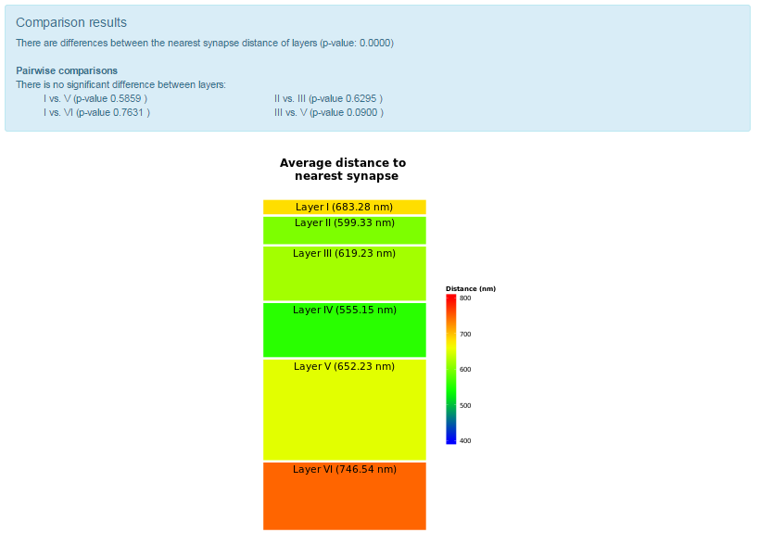
Layer comparison
Nearest synapse
Select Distance to nearest synapse and hit Calculate
For each synapse, the distance to its nearest synapse in the same sample is computed
Results are aggregated for each layer computing the sample volume-proportional mean distance

Slide 19
Contact
Computational Intelligence Group
Email: luis.rodriguezl@alumnos.upm.es , l.anton-sanchez@upm.es
Phone: +34-913363675
Web page: http://cig.fi.upm.es/

