Slide 1
SP5 - Neuroinformatics 3DSomaMS
Tutorial
Computational Intelligence Group
Technical University of Madrid

Slide 2
Outline
Installation
Load data
Modelling somas
Create simulations

Slide 3
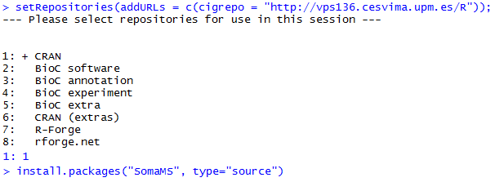
Installation
Guidelines
Demo available online at http://vps136.cesvima.upm.es:3838/hbp/somaMS/
Installation
R environment and internet access required
Add CIG R Repository
Install 3DSomaMS package (only preprocessing included)
Run
Load 3DSomaMS library
Run graphical user Interface
More info and examples at: http://cig.fi.upm.es/?q=3DSomaMS

Slide 4
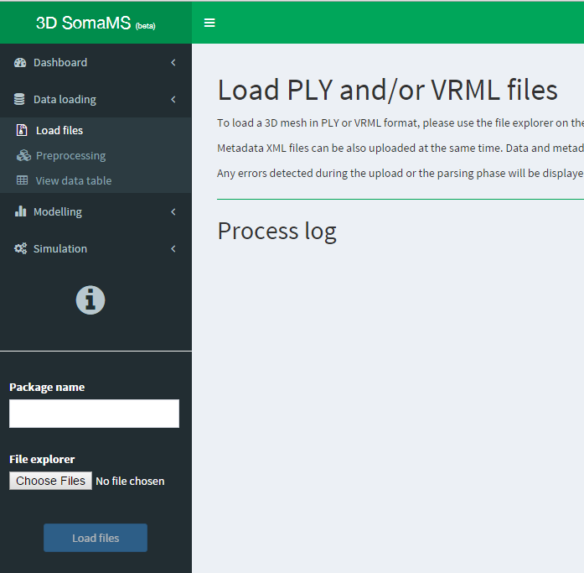
Load data
How to upload a new neuron
Navigate to Data loading Load files
A new menu is shown in the sidebar
Give a name to the uploaded neurons
Use File explorer to select VRML, PLY or ZIP files
You can select several files at the same time
Click Load files
Information about the uploading process is displayed in Process log box

Slide 5
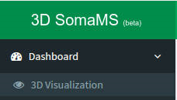
Load data
Uploaded somas information
In the Dashboard principal tab you will find a summary table
That table depicts the status of every soma loaded
Also there are some boxes giving some key values in the application
Number of somas loaded
Number of models
Number of simulations

Slide 6
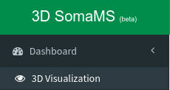
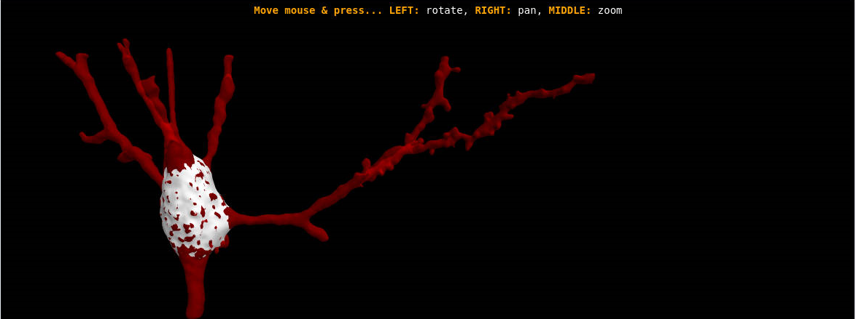
Load data
3D Visualization tab
Interactive 3D plot of any soma
In the left sidebar select Dashboard
Then choose 3D Visualization
To navigate use the keyboard:
WASD to move
RF up and down
QE to roll (rotation)
Arrows up and down to pitch
Arrow left and right to yaw

Slide 7
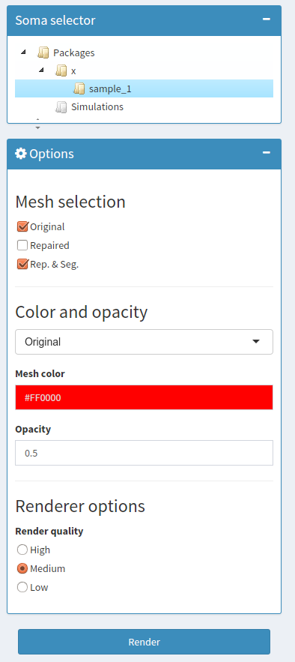
Load data
3D Visualization tab
Select a loaded neuron or a simulated one
Select the state of the soma to render
Several options can be checked at the same time
Select color and opacity for each selected mesh
Quality of the renderization
Regard that higher quality, slower rendering

Slide 8
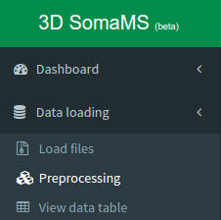
Load data
Preprocessing
Goals:
Repair holes produced in the surface of the soma by the staining process
Remove the initial part of the neurites if they are included in the original mesh
Characterize morphology of the somas to model them in next steps
To preprocess the soma, navigate:
Go to Data loading tab on the left sidebar
Click Preprocessing tab

Slide 9
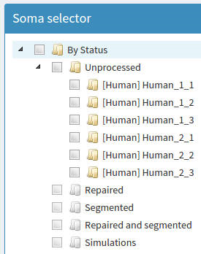
Load data
Preprocessing
Soma selector
Check neurons to preprocess
Individual neurons
Folder to preprocess all the neurons inside it
Operations
Check any combination of preprocess operations and they will be chained
Click Run processes to apply them to selected neurons

Slide 10
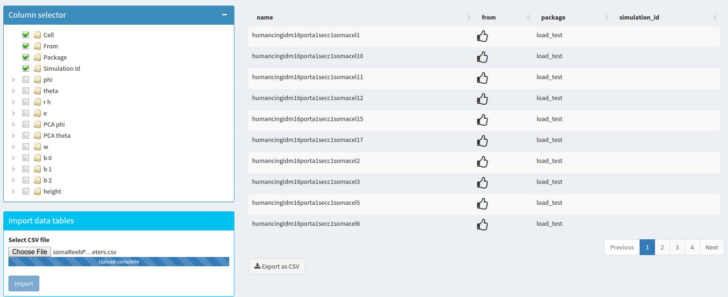
Load data
Characterization data table
In Data loading View data table, show characterization information in a table
Check column selector to choose information displayed in the table
Import previous characterizations or export current characterization in a CSV file

Slide 11
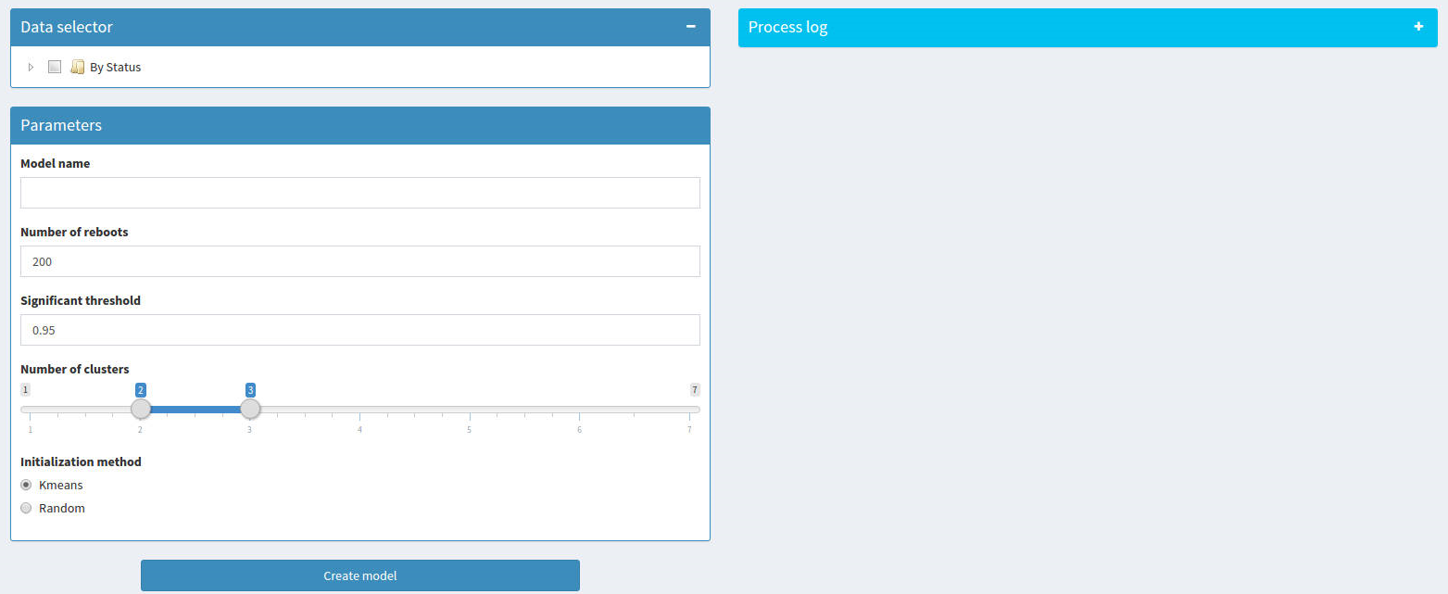
Modelling somas
Clustering
Learn the structure of a Bayesian network and apply it to cluster according to the soma characterization
Navigate to Modelling tab and select New model
Select data in Data selector, fill Parameters boxes and click Create model
Information about the structure learning and clustering can be found in Process log

Slide 12
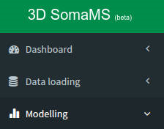
Modelling 3DSomaMS
Model information
In the Modelling principal tab you will find a summary table
That table depicts the general information about computed models
Also there are some boxes giving some key values in the application
Number of models
Average number of arcs in the Bayesian networks
Average number of clusters found by each model

Slide 13
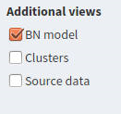
Modelling 3DSomaMS
Model visualization
Explore every model in the application
In Model selector choose a model
Some general information about the model will be displayed
Also a table is included with additional information of the neurons used to model
Additional views are included
BN model
Clusters (Not implemented yet)
Source data

Slide 14
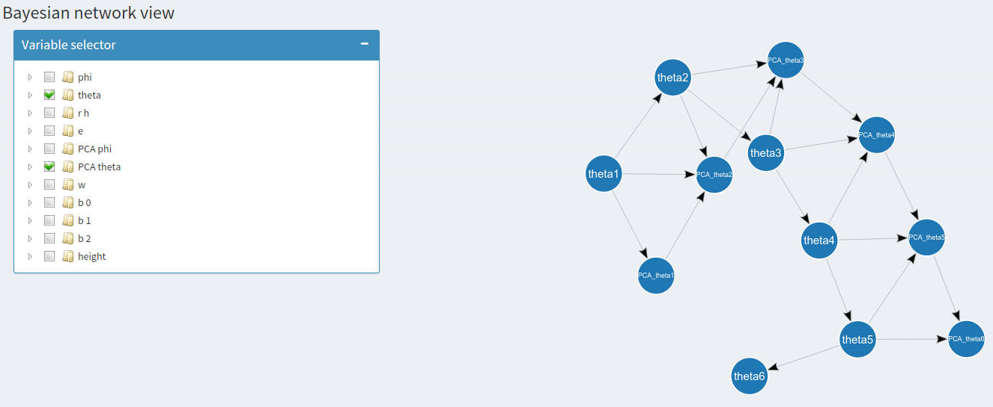
Modelling 3DSomaMS
Bayesian network view
In Explore model tab select a model, then go to Additional Views and check BN view
Variable selector lists the variables of the model that will be displayed on the right graph
Nodes of the graph can be drag and drop by the user to improve visualization

Slide 15
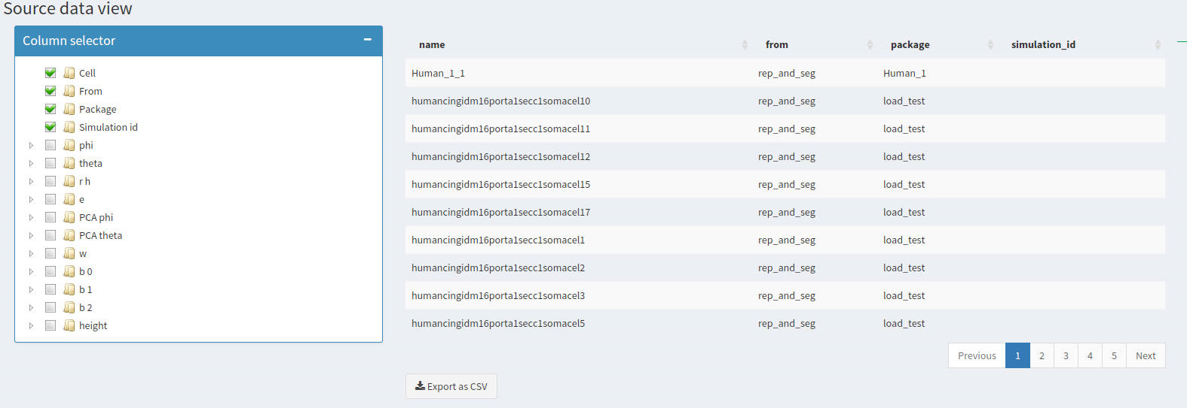
Modelling 3DSomaMS
Source data view
Display morphological information of the data used to obtain the model
In Explore model tab select a model, then go to Additional Views and check Source data
Use Column selector to chose the columns of the table
Click Export as CSV to download all the dataset (Column selector does not affect)

Slide 16
Create simulations
Sample from model
Generate new three-dimensional somas from the Bayesian network model
Select a model to sample from it
Select one of the clusters of that model or sample from of all them according to prior distribution
Indicate the number of somas to sample
Run the simulation
Visualize the simulated somas in the Dashboard 3D Visualization tab
Simulated data can be downloaded as a CSV in Data loading View data tables
Information about the clustering can be found in the Simulation log

Slide 17
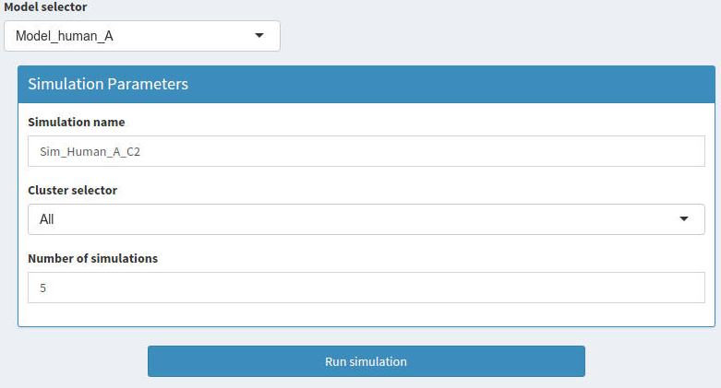
Create simulations
Set parameters
Simulation is determined by three parameters: Model name, cluster number and number of simulations
Select one of the previously computed models
Give a name to the simulation
Select a cluster or “All”
to use prior distribution
over clusters
Number of somas to simulate
Start simulation

Slide 18
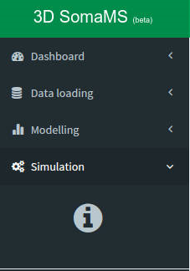
Create simulations
General information
In the Simulation principal tab you will find a summary table
That table depicts the general information about simulated somas

Slide 19
Contact
Computational Intelligence Group
Email: luis.rodriguezl@alumnos.upm.es , sluengo@fi.upm.es
Phone: +34-913363675
Web page: http://cig.fi.upm.es/

